Slide 1

An FE implementation of coupled resin flow and preform in ABAQUS
2023-06-29
Mohammad Rouhi
FPCM15, June 2023, Purdue University, Indiana, USA

Slide 2

Content
Introduction
Motivation
Established 2D Framework
3D Framework
Implementation
Post-processing capabilities
Conclusion & Prospect
Senior Researcher at
RISE Research Institutes of Sweden
FPCM15, June 2023, Purdue University, Indiana, USA

Slide 3
Motivation
In Swedish industry no process simulation
  No budget
  No time
  Inefficient commercial softwares
  Expensive licenses
  etc….
The question comes:
  Can’t we do with the current simulation tools we have?
FPCM15, June 2023, Purdue University, Indiana, USA

Slide 4
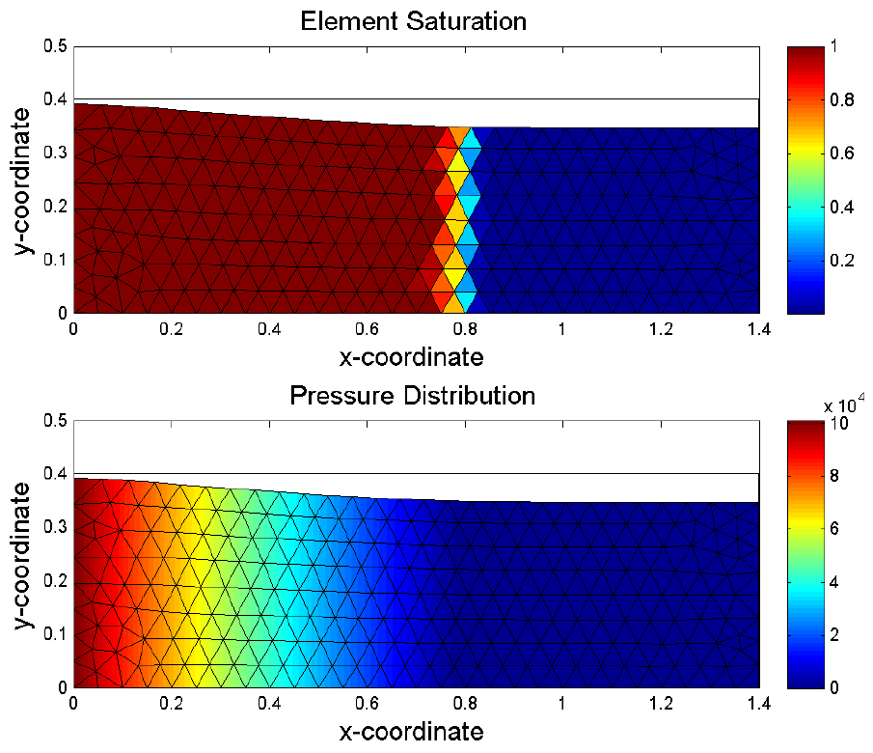
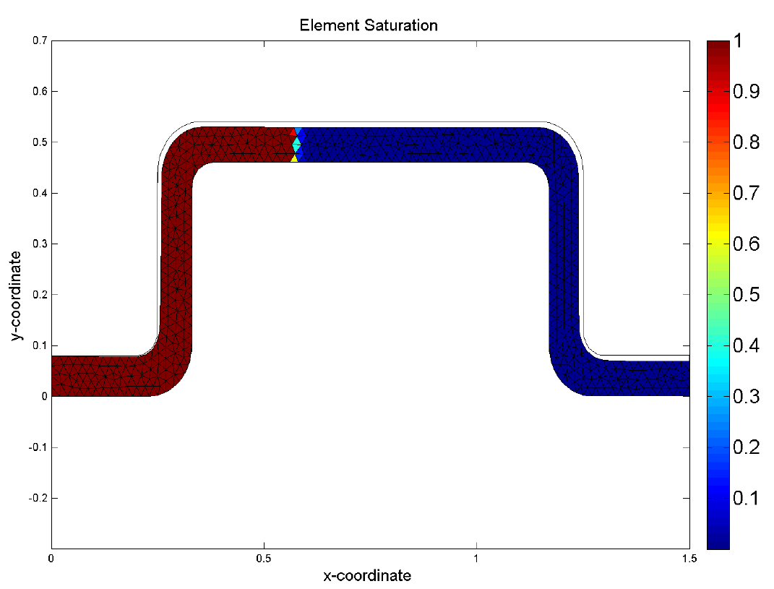
Established 2D Framework
Larsson R, Rouhi M S, Wysocki M, 'Free surface flow and preform deformation in composites manufacturing based on porous media theory', European Journal of Mechanics - A/Solids, Volume 31, Issue 1, January-February 2012, Pages 1-12.
Rouhi M S, Wysocki M, Larsson R, 'Modeling of coupled dual-scale flow-deformation processes in composites manufacturing', Composites Part A: Applied Science and Manufacturing, Volume 46, March 2013, Pages 108-116.
Rouhi M S; Wysocki M; Larsson R, Experimental assessment of coupled dual-scale flow-deformation processes in composites manufacturing. Journal of Composites Part A: Applied Science and Manufacturing, Volume 46, 2015, 215–223.
Rouhi M S, Wysocki M, Larsson R, 'Holistic modeling of composites manufacturing using poromechanics', Advanced Manufacturing: Polymer & Composites Science, Volume 2, Issue1, 2016, pages 1-13
FPCM15, June 2023, Purdue University, Indiana, USA

Slide 5
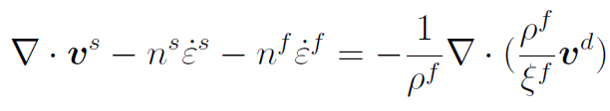




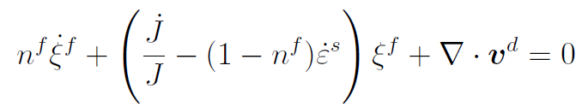


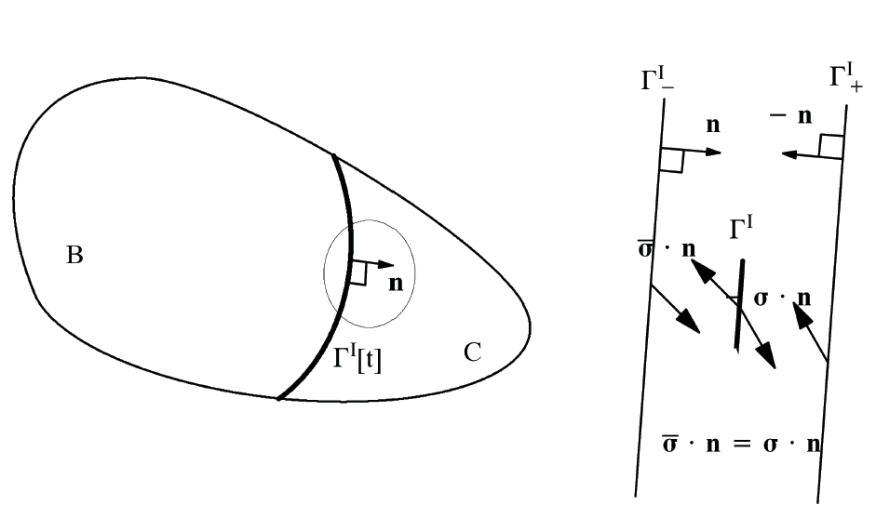
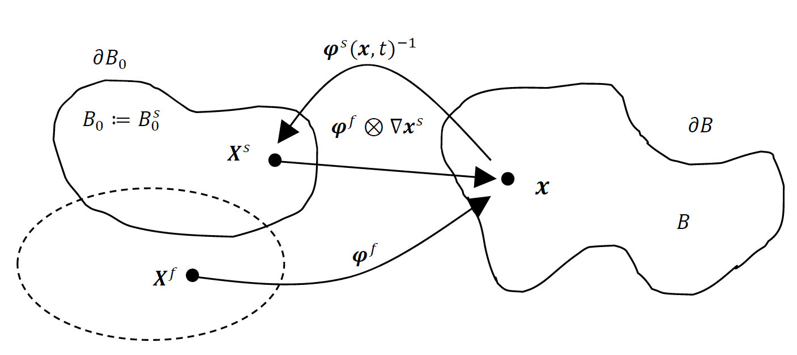
Established 2D Framework
Physical assumptions
Micro-constituents
Governing equations
Constitutive equations
Solution procedure
Flow front tracking
FPCM15, June 2023, Purdue University, Indiana, USA

Slide 6
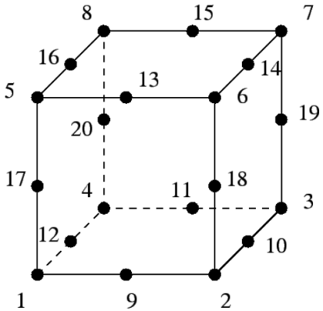
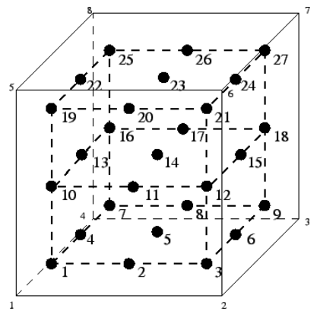
3D Framework
3D stress state
Coupling effects
Laminate wall constructions be possible
Through the Thickness Flow Modeling
Element Selection
Element Development
Element Application
20-node Solid Shell Element
3 Displacement DOFs per node
1 Pressure DOF per corner nodes
Quadratic Shape Functions for Displacement
Linear Shape Functions for Pressure
Solid Shell Elements
FPCM15, June 2023, Purdue University, Indiana, USA

Slide 7
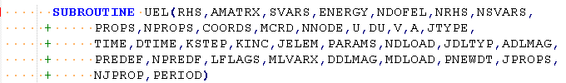
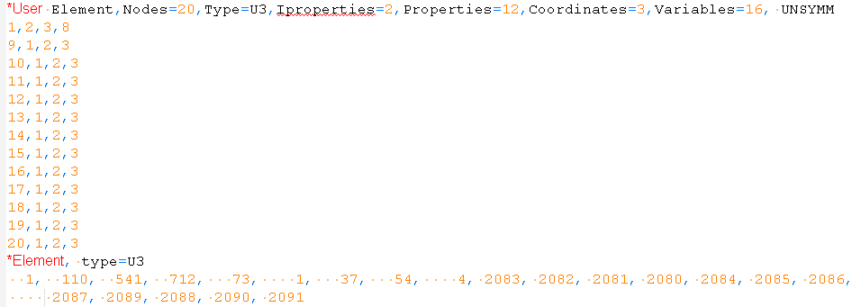
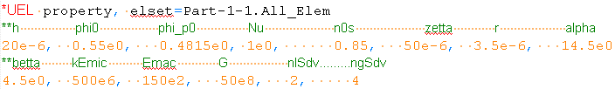
Implementation
FPCM15, June 2023, Purdue University, Indiana, USA

Slide 8
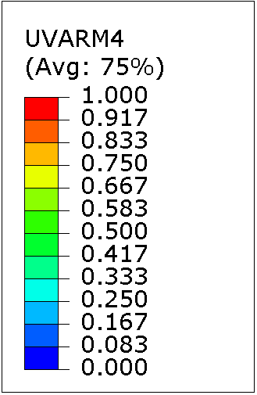
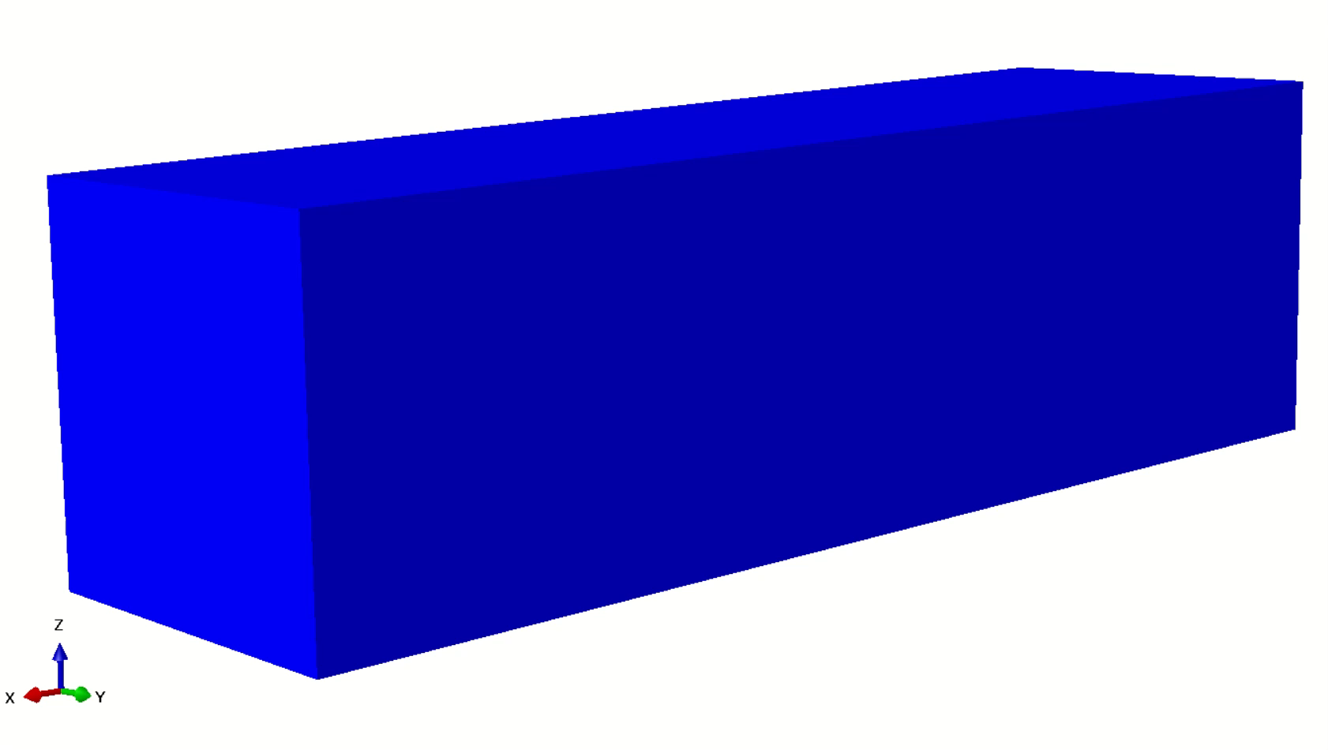
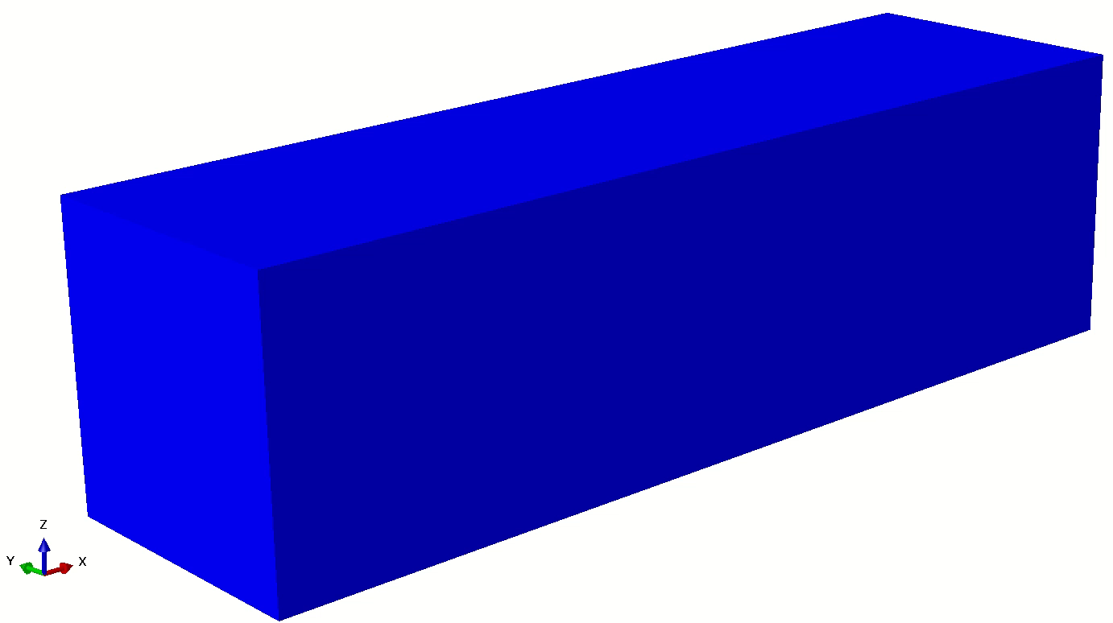
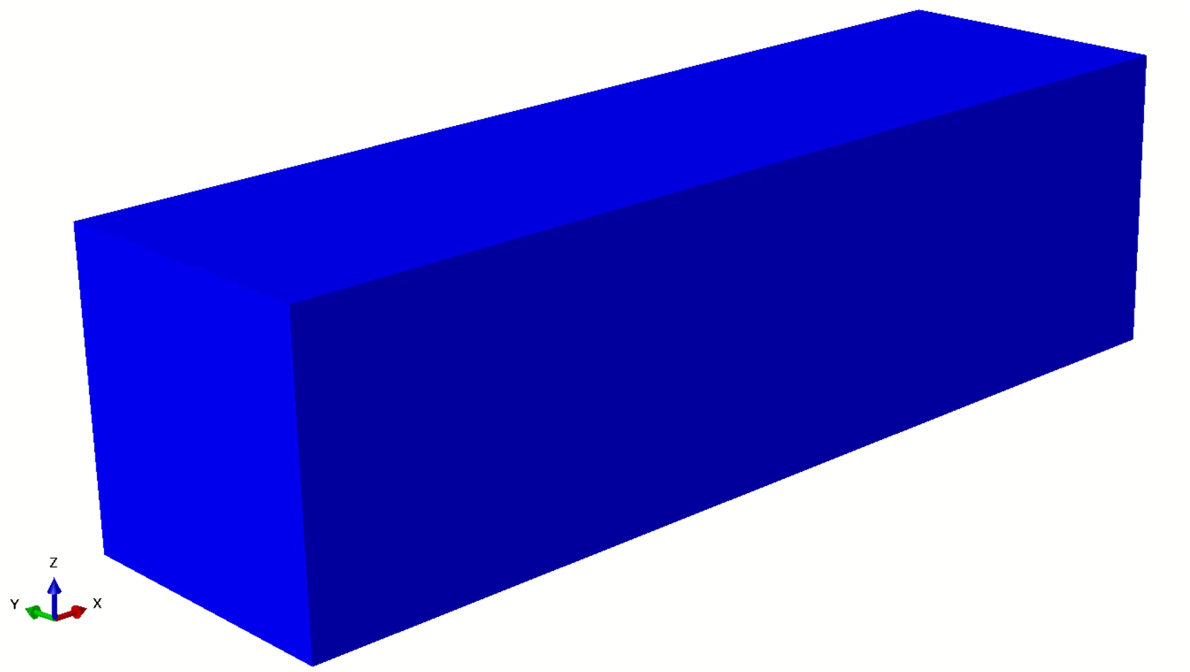
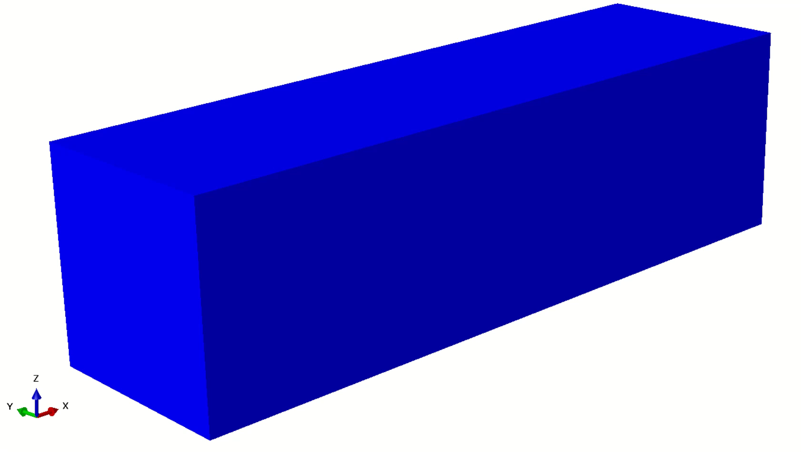
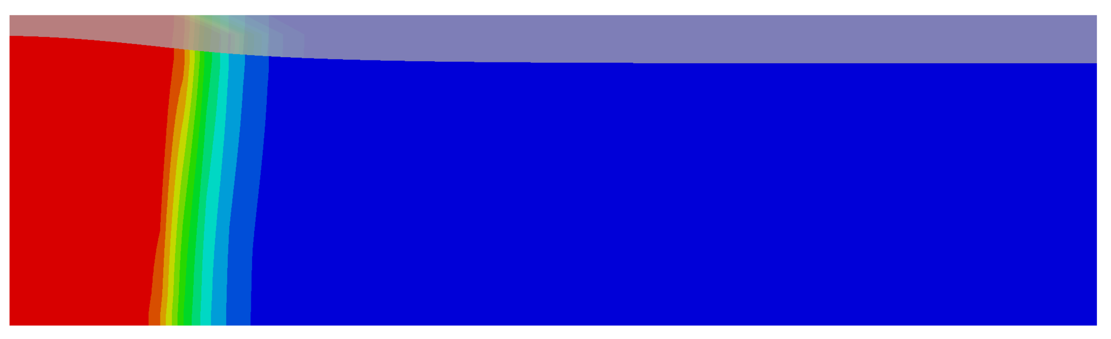
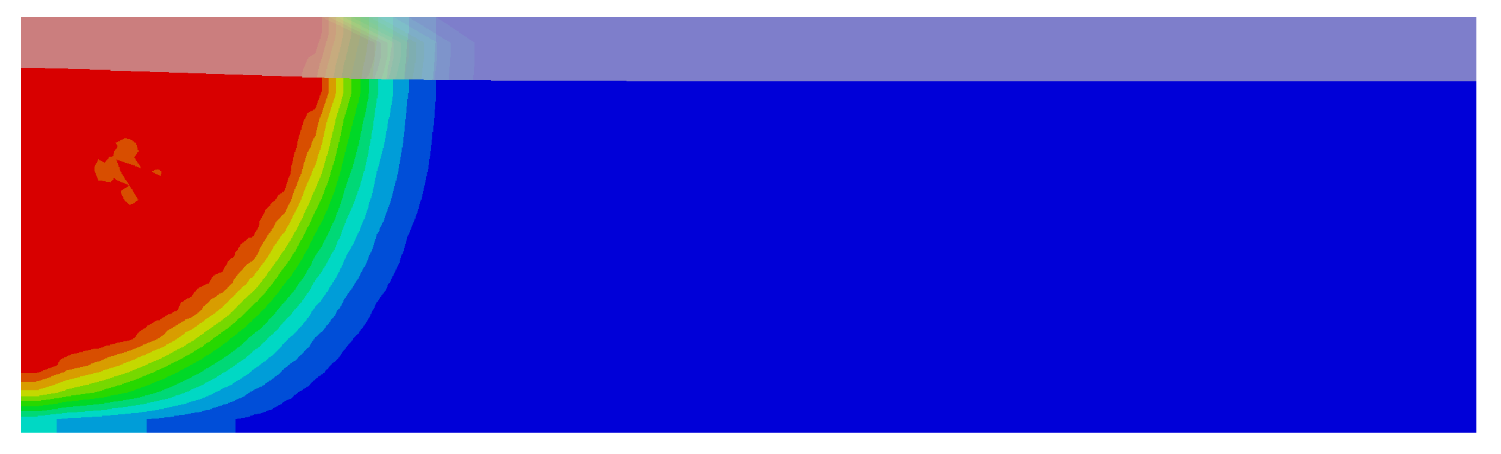
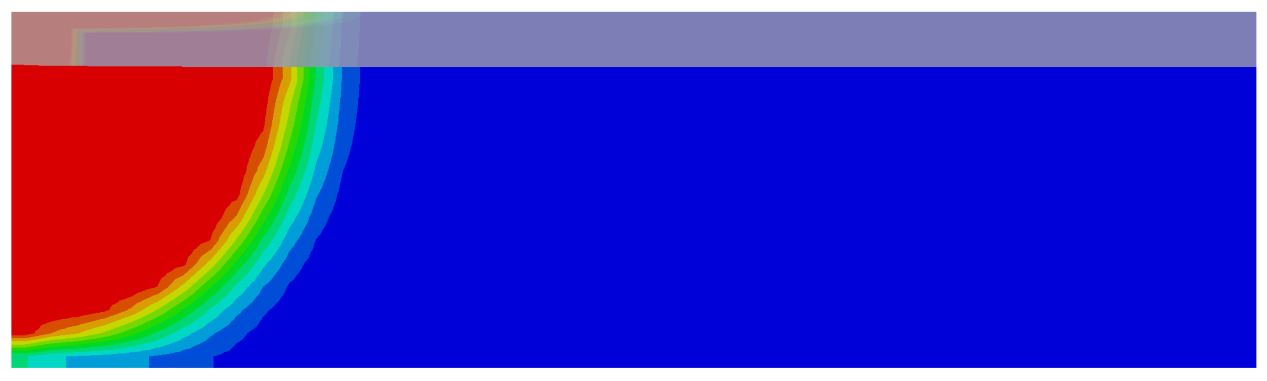

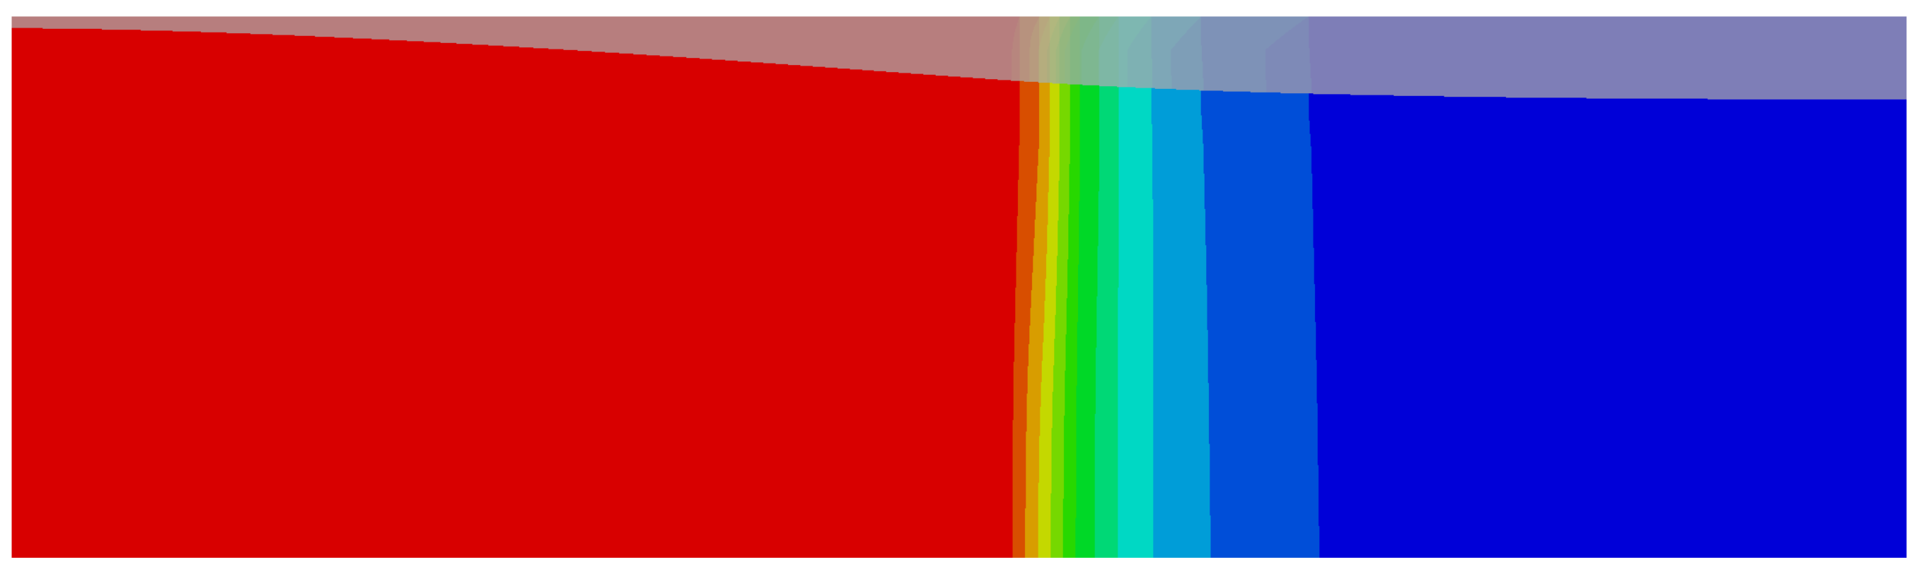
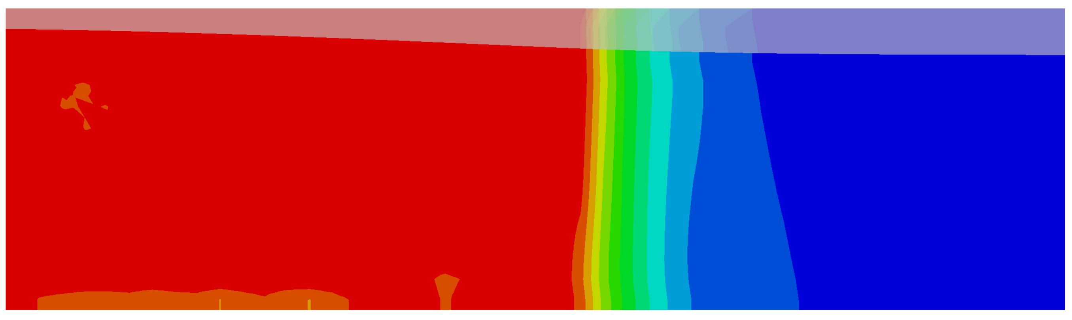
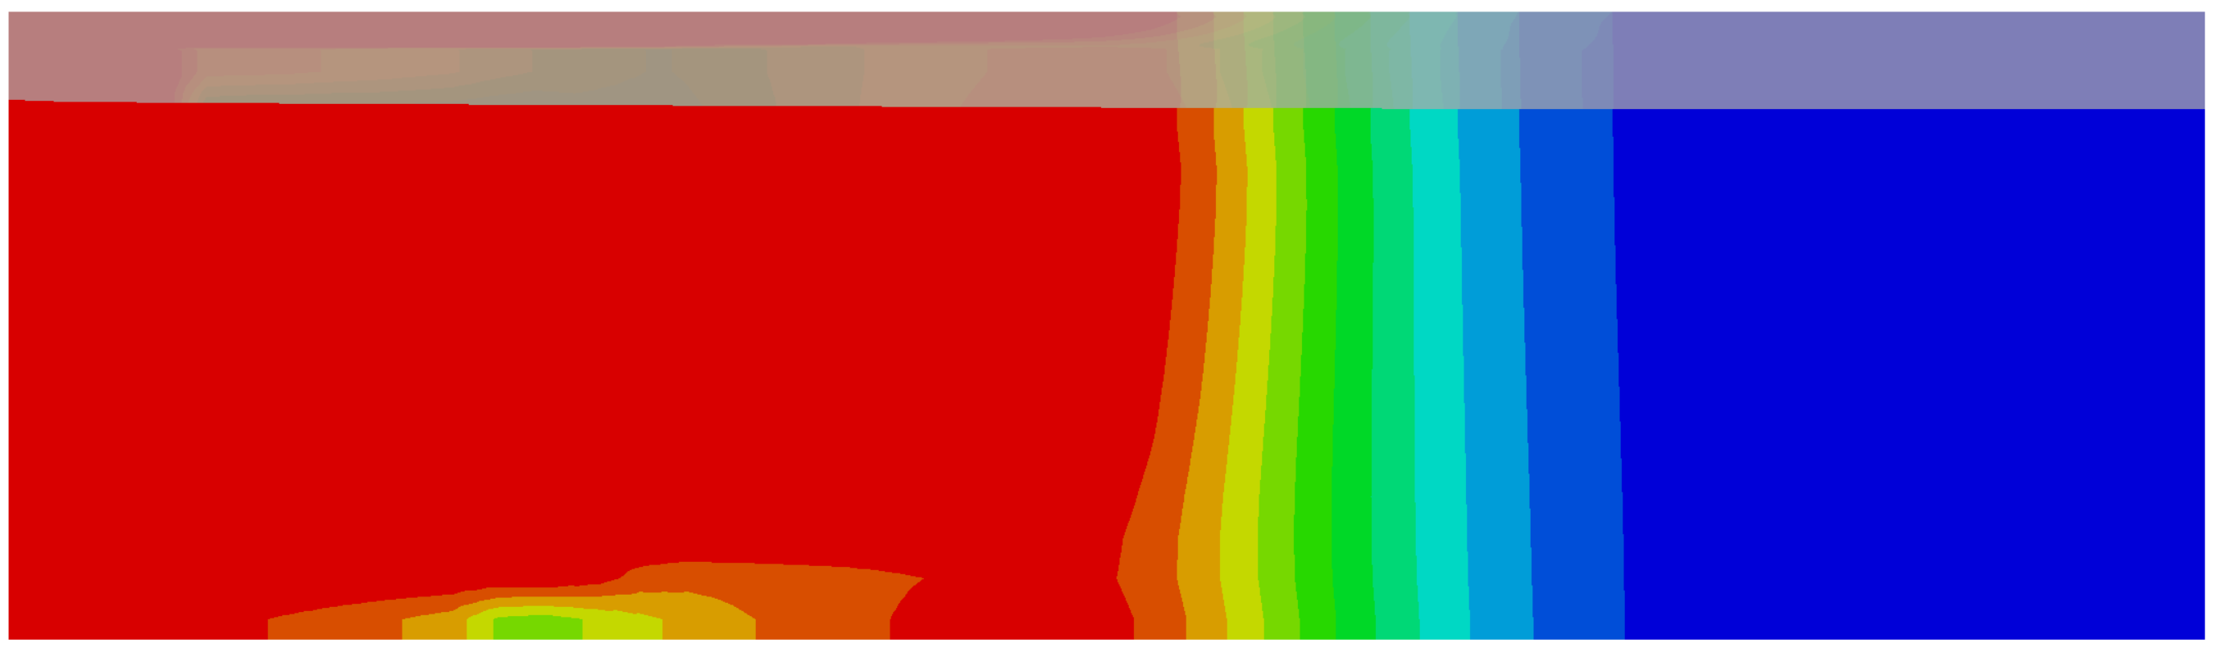
Results - Saturation degree
FPCM15, June 2023, Purdue University, Indiana, USA

Slide 9
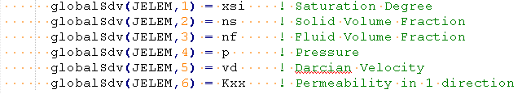
Results - Post processing
Permeability
Reaction forces
Velocities
Saturation degree
Pressure distribution
Deformation profile
Drainage
FPCM15, June 2023, Purdue University, Indiana, USA

Slide 10
Future work
Add curing with a time-dependent resin viscosity
Add laminate wall construction
Speed up the simulation routine
Design graphical user interface
FPCM15, June 2023, Purdue University, Indiana, USA

Slide 11
Mohammad Rouhi
  Mohammad.rouhi@ri.se
  +46 10 228 49 68

